Slide 1


Department of Artificial Intelligence and Data Science
HOUSE PRICE PREDICTION
BHARKAVI N
231801023
DARSHINI S
231801023

Slide 2
Problem Statement
Develop a machine learning model to predict house price based on various features such as number of bedrooms, square footage, location and other relevant factors.

Slide 3
Objectives
To develop a predictive model that estimates house prices based on a variety of input features, such as location, square footage, number of bedrooms and bathrooms, age of the property, and local economic indicators. The model aims to provide reliable price predictions that can help stakeholders navigate the housing market more effectively.

Slide 4
Abstract
This project develops a machine learning model to predict house prices based on key features such as location, square footage, and number of bedrooms. By analyzing historical housing data, the model identifies patterns that influence property values, providing accurate and reliable price estimates. The outcome aims to assist buyers, sellers, and real estate professionals in making informed decisions within the housing market.

Slide 5
Introduction and Overview of the Project.
The housing market is influenced by various factors, making accurate price estimation essential for buyers, sellers, and investors. Traditionally, house pricing relied on subjective evaluations, but advancements in machine learning and data analysis offer a more systematic approach. This project focuses on creating a predictive model that leverages diverse datasets, including property characteristics and economic indicators, to forecast house prices. The goal is to provide stakeholders with valuable insights, enabling better decision-making in a dynamic real estate landscape

Slide 6
Existing System
Linear Regression: Predicts based on linear relationships between features.
Decision Trees & Random Forests: Split data and aggregate results for better accuracy.
Gradient Boosting (e.g., XGBoost): Sequential tree-building for improved predictions.
Deep Learning: Handles complex relationships in large datasets.
Support Vector Machines:Effective for high-regression.

Slide 7
Drawback of Existing System
Linear Regression: Struggles with non-linear data.
Decision Trees: Prone to overfitting.
Gradient Boosting & Deep Learning: High computational cost.
Random Forests & Neural Networks: Lack of interpretability.
.

Slide 8
Drawback of Existing System
Data Quality: Struggles with missing or noisy data.
No Temporal/Geospatial Factors: Doesn’t account for market changes or location differences

Slide 9
Proposed System
DATA COLLECTION
1. Historical Housing Data:
Sales prices, property features (size, bedrooms, bathrooms), and transaction dates.
2. Economic Indicators:
4.Market Trends:
5. Additional Factors:
3. Geographic Data:
Median income, employment rates, and economic growth data.
Location attributes such as neighborhood characteristics and proximity to amenities (schools, parks).
Historical trends in property prices, average days on market, and inventory levels.
Property age, condition, and unique features (e.g., pool, garage).

Slide 10
Proposed System: DATA PREPARATION
1. Data Cleaning:
4. Data Splitting:
5. Data Validation:
3. Feature Engineering:
Split dataset into training (80%) and testing (20%) sets.
Handle missing values (imputation/removal).
2. Data Transformation:
Create new features (e.g., price per square foot, property age).
Select important features using correlation analysis.
Normalize/standardize numerical features.
Encode categorical variables (one-hot/label encoding
Implement k-fold cross-validation for robustness.
Remove duplicate entries.
COLLECT THE DATA
HANDLING NULL VALUES AND MISSING DATA
FIND THE CORRELATION USING HEAT MAP
REGULARISATION

Slide 11
DATA PREPARATION
STEP 1:DATA CORRECTION
Check for missing values
Handle Missing Values
Correct Data Types
STEP 2:DATA PREPROCESSING
One-Hot Encoding for Categorical Variables
Feature Scaling
Prepare Features (X) and Target (y)

Slide 12
DATA PREPARATION
STEP 3: HEATMAP (CORRELATION ANALYSIS)
Feature Selection: List the columns relevant to your model (update the features list as per your dataset).
Correlation Matrix: Only the selected features are used to compute correlations.
Heatmap: Visualizes correlations, highlighting key relationships affecting SalePrice

Slide 13
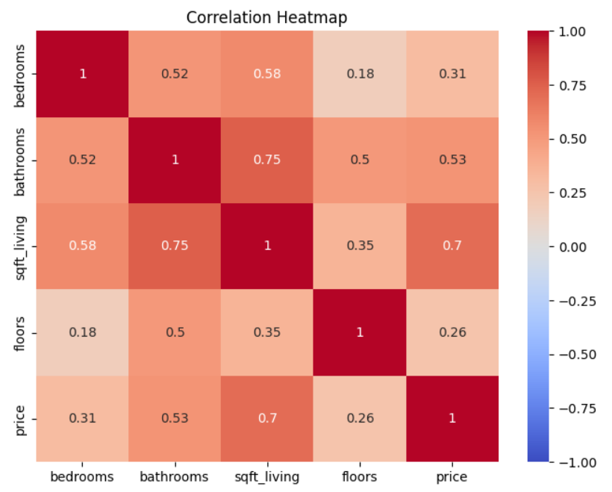
DATA PREPARATION

Slide 14
DATA PREPARATION
STEP 4: Train-Test Split
split the data into training (80%) and testing (20%) sets
STEP 5: MODEL TRAINING
train a machine learning model (e.g., Linear Regression) on the training data.
STEP 6: MODEL TESTING
After the model is trained, use it to predict house prices on the test set.
First Review

Slide 15
DATA PREPARATION
STEP 7:CROSS VALIDATION
To ensure the model generalizes well, we can perform K-fold cross-validation.
STEP 8:ACTUAL VS PREDICTION
To better understand the model’s performance, visualize actual vs predicted prices.
STEP 6:CONFUSION MATRIX
Finally, evaluate the performance using a confusion matrix and classification report.
First Review
Department of Artificial Intelligence and Machine Learning
Department of Artificial Intelligence and Data Science

Slide 16
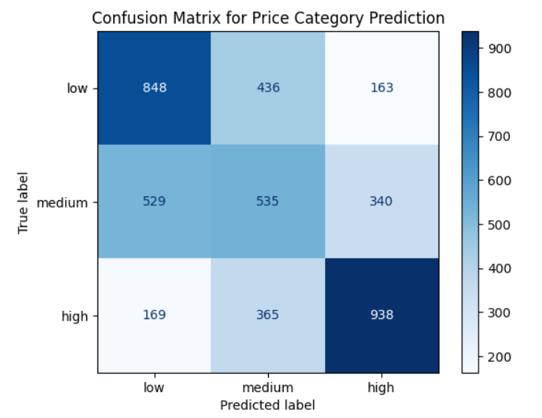
DATA PREPARATION

Slide 17
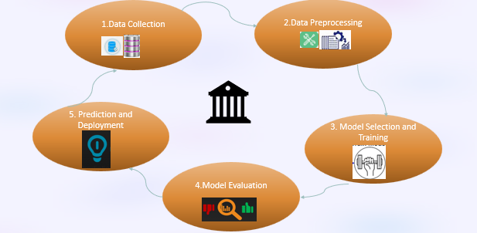
System Architecture

Slide 18
Modules - WORKFLOW
Gather historical housing data, economic indicators, and geographic information from reliable sources (e.g., real estate databases, government records).
Evaluate both models using appropriate metrics.
Monitor the model’s performance regularly and make adjustments as necessary to adapt to evolving market trends.
Split data into training and test sets.
Preprocess data to handle missing values and encode categorical variables.
Train the final model on the complete training dataset with optimized parameters.
Deploy the model for real-time price predictions, allowing users to input property features.
Continuously update and retrain the model with new data to ensure accuracy over time as market conditions change.

Slide 19

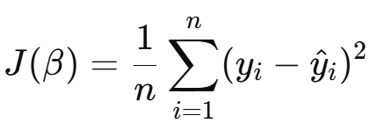
Modules
MODEL TRAINING :
Linear Regression:
Mean squared Error
(cost function) :

Slide 20
Module 1
Results
Feature Importance:
Identify key features influencing house prices (e.g., location, square footage).
Use visualizations (e.g., bar charts) to illustrate feature significance.
Predictions vs. Actual Prices:
Show a comparison of predicted prices versus actual prices using scatter plots.
Highlight areas of accurate predictions and notable discrepancies.
Model Performance:
Present evaluation metrics (e.g., RMSE, R-squared).
Compare multiple models (e.g., linear regression, decision trees) to highlight the best performer.

Slide 21

Conclusion
Summary of Findings:
Recap the effectiveness of the predictive model in estimating house prices.
Future Work:
Recommend areas for further research (e.g., incorporating additional data sources, exploring advanced algorithms).
Final Thoughts:
Emphasize the importance of data-driven insights in the real estate market and the potential for improved decision-making.

Slide 22
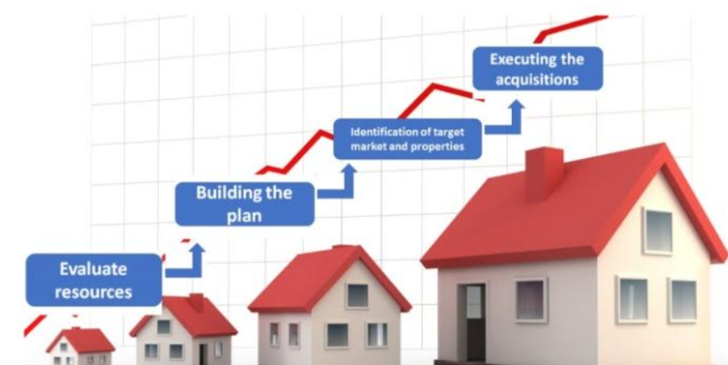
References.
HOUSE PRICE PREDICTION – BY VARUN THYAGI
ML HOUSE PREDICTION MODEL – PYTHON GEEKS
HOUSE PRICE PREDICTION – BY ABISHEK SHARMA

Slide 23
Thank You

